Slide 1


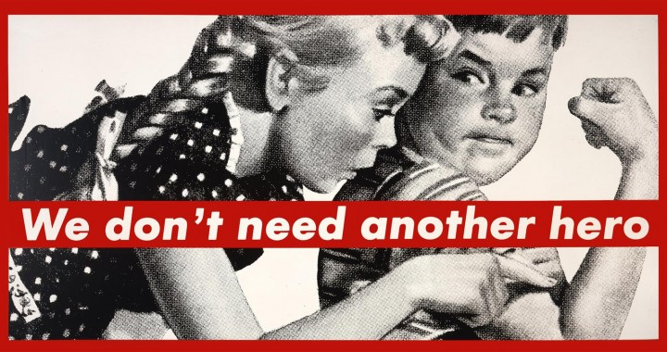

Slide 2
Choose either pink or blue. Research its visual history and create a short summary of how its meaning has changed across time, media, or cultures.
PINK OR BLUE RESPONSE:

Slide 3
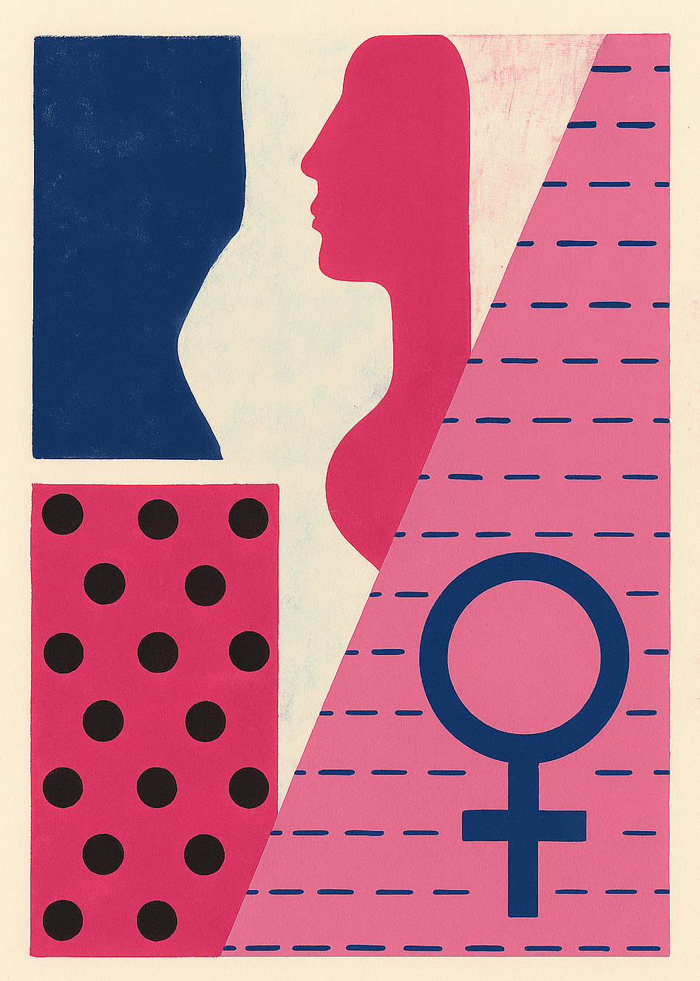
PRACTICAL ACTIVITY
Task: Create an abstracted artwork that explores gender-specific symbolism and colour.
Objective: To investigate how gender roles, identity, and cultural norms can be expressed or subverted through colour, symbol, and composition.
What colour or object best represents your experience or response to gender expectations?
Instructions:
Select a gender-related idea, stereotype, or experience you want to explore.
Choose colours associated with gender identity or symbolism.
Include abstracted or reimagined symbols (toys, objects, fabrics, patterns).
Use 2D, 3D or time-based media to resolve a visually coded response.
Avoid literal representation. Focus on colour, symbols, repetition, layering, and abstraction.
Formal Context: How does repetition, shape, texture, or spatial design construct a visual language?
Cultural Context: How does your work connect to social constructs of gender across time or in your own life?

Slide 4
Researching: How did you react to stimulus?
Insert clear image of artwork
Crop the image to frame the work (nothing in the background)
Developing: How did you generate solutions to visual problems? Insert a photograph/s detail of the artwork below
Reflecting: How did you consider ideas and information, media techniques and processes?
Evaluate: How successful was the experiment? Why?

